Slide 1

SLIDE #1
EMPLOYEE ATTRITION
Team Members Names: SAMPATH
KUMAR, SHEETAL RAPOLE, BALA
BOOMIKA, NAVYA, RAAJITHA.

Slide 2

Contents of the Presentation:
1.Overview
2.KPIs
3,4.Dashboard images
5.Insights
6.Thank you

Slide 3

SLIDE #3
OVERVIEW
Employee attrition rate, also known as staff turnover or employee churn, is a metric that measures the percentage of employees who leave an
organization over a specific period of time. It is a crucial indicator for businesses to assess the stability and health of their workforce. The attrition rate
is typically calculated by dividing the number of employees who leave during a given period by the average number of employees during that same
period, then multiplying the result by 100 to express it as a percentage.
A high attrition rate can have several implications for an organization. It may indicate dissatisfaction among employees, lack of engagement, or issues
with the work environment. High turnover can be costly for businesses due to recruitment and training expenses, as well as potential disruptions in
productivity and team dynamics.

Slide 4
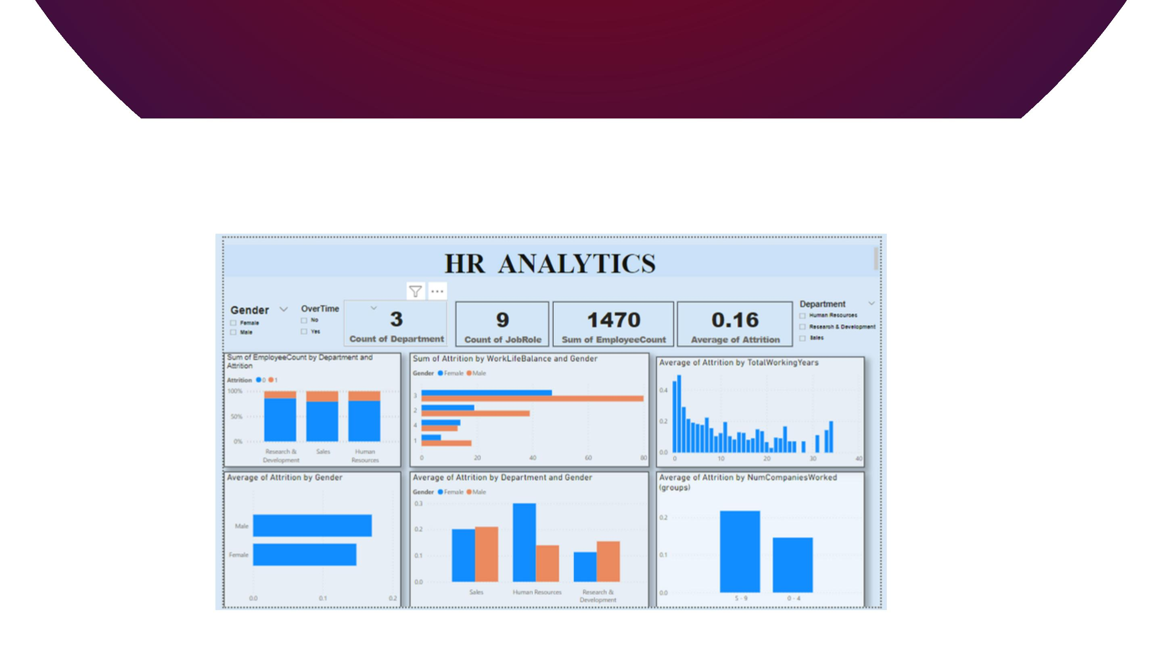
DASHBOARD IMAGES

Slide 5

SLIDE #5
KPI
Overall Employees-1470
➢ Attrition-237
➢ Attrition Rate-16.12%
➢ Active Employees-1233
➢ Average Age-36.92
Approximately 37

Slide 6
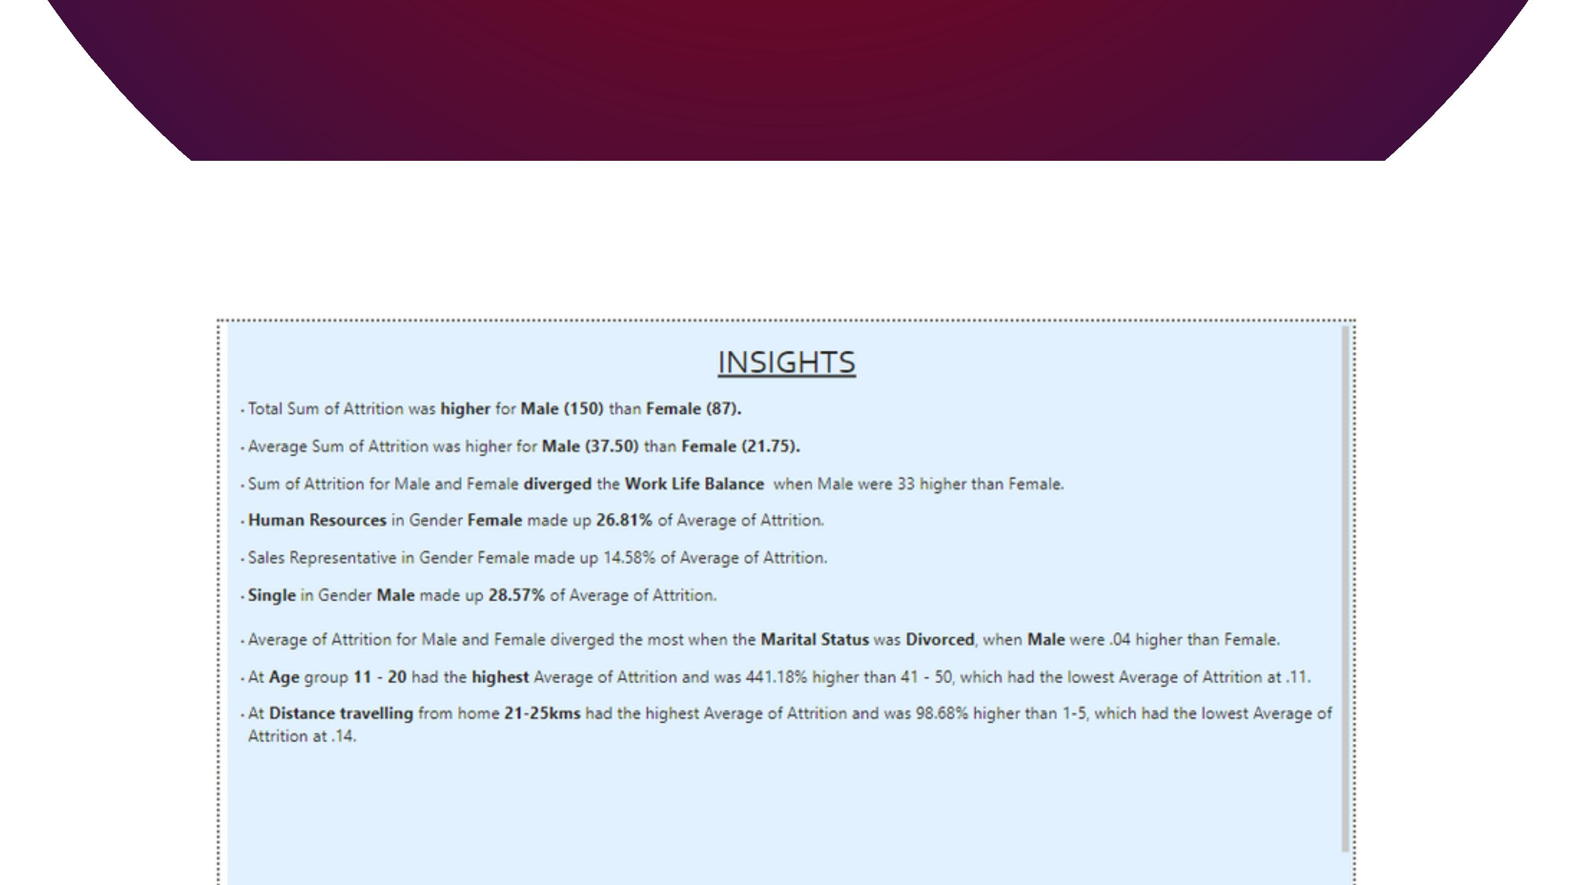
INSIGHTS

Slide 7
SLIDE #7
THANK YOU
Github:-
Linkedin:-
https ://github. com/R a a jitha goud
https ://www. linke din. co m/in/ra a jitha - go ud- 6b5b4618b/

Slide 8

U
O

